Slide 1
Software Architecture Principles and patterns
Shidlingayya G (Siddu)
Oct - 2022

Slide 2
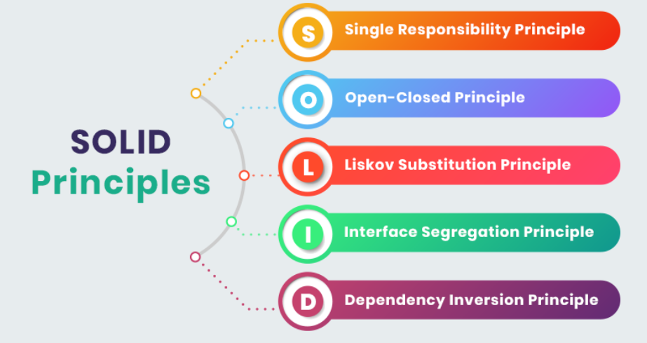
Software Architecture Principles
Single Responsibility Principle
Open-Closed Principle
Liskov Substitution Principle
Interface Segregation Principle
Dependency Inversion Principle

Slide 3
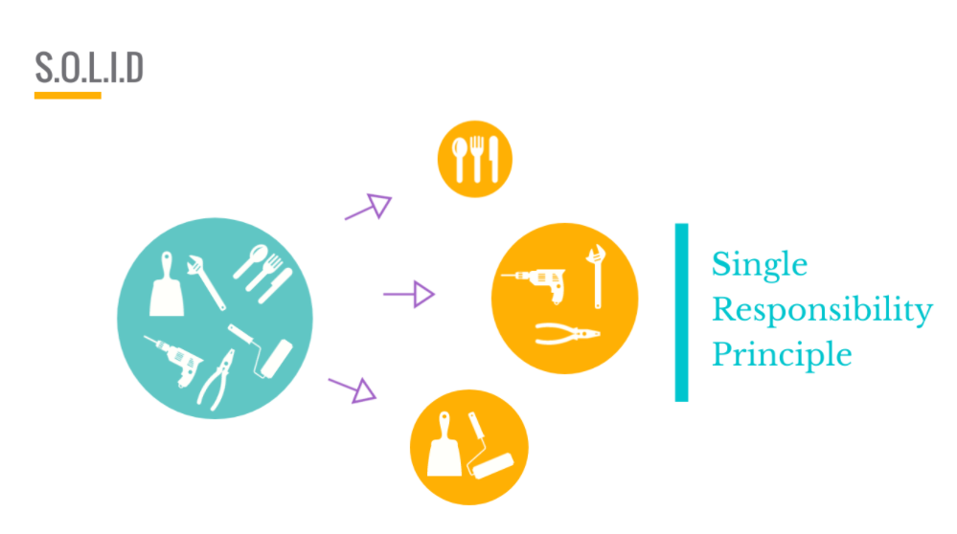
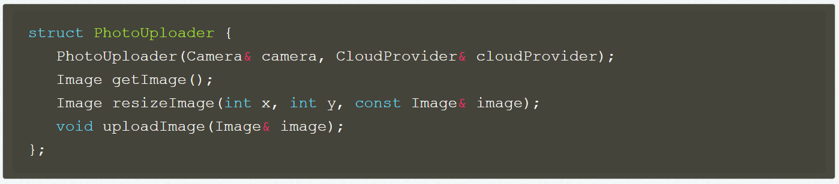
Single Responsibility Principle
The principle states that every module or class or function should have single responsibility and it should encapsulate that part of the functionality
The software designed with Single Responsibility makes software simple and avoids side effects in future software modifications
The more responsibility we add to the class more frequency we may need to modify the class
With SRP - the class easier to maintain, easy to understand and easy to reuse
This violates SRP because all the functionalities such as taking photo, resize, upload etc all handled in single class PhotoUploader

Slide 4
Open closed Principle (OCP)
The concept states that – The software should be open for extension, but should be closed for modification
The software should be extendable without modifying its source code
To achieve the Open closed principle – The “Abstraction” is the key while designing software
Implementation guidelines
The simplest way to implement OCP is through “Inheritance” concept – The new functionality can be extended in the form of derived classes without touching existing functionality
Another way to implement using Abstraction - All the class to access the interface using abstraction
Advantages:
Extensibility: The OCP principle encourage design module that never change, When requirement is changed then it can be extended with Inheritance
Maintainability: The OCP supports abstraction i.e interface which enables loose coupling of the modules or functions. The modules are independent each other and easily cope-up with dynamic change in requirements from the customer
Flexibility: OCP provides Plugin architecture - The new code can be extended with Plugin without modifying existing software

Slide 5
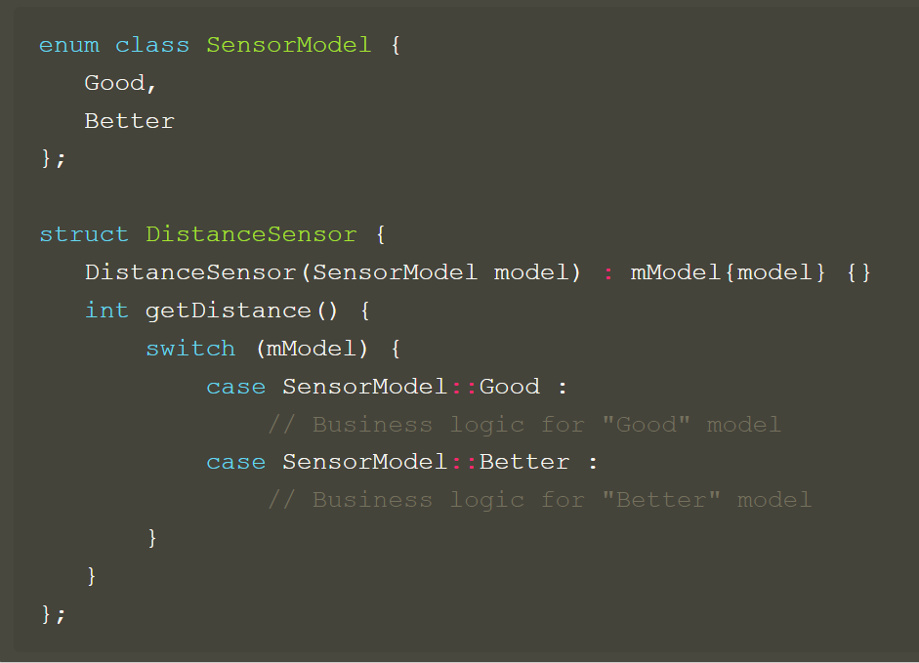
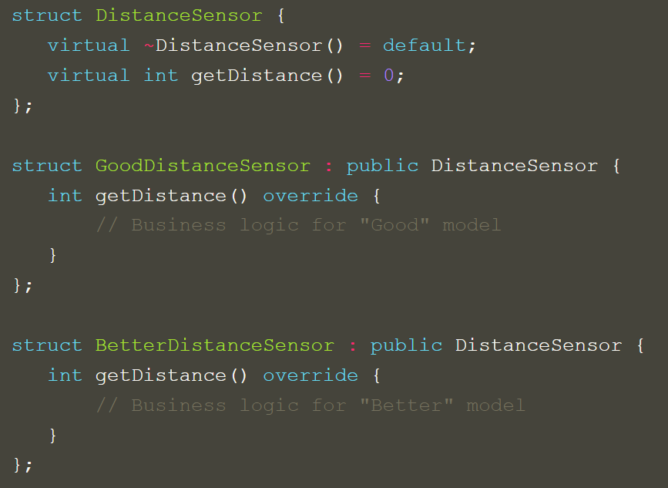
Open closed Principle (OCP) continued …
The OCP rule is violated here because if we want to add new sensor then original code needs to be modified.
The OCP rule is not violated here because with interfaces it is easy to add the new sensor functionality which is closed for modification and open for extendibility

Slide 6
Liskov Substitution Principle
The principle defines that objects of a superclass shall be replaceable with objects of its subclasses without breaking the application.
That requires the objects of your subclasses to behave in the same way as the objects of your superclass.
If S is a subtype of T, then objects of type T in a program may be replaced with objects of type S without altering any of the desirable properties of that program (e.g. correctness)
This rule can be applied in cases where return values and arguments of the child classes are consistent with base classes.
Functions that use pointers or references to base classes must be able to use objects of derived classes without knowing it.
It is based on the concept of "substitutability" – a principle in object-oriented programming stating that an object (such as a class) and a sub-object (such as a class that extends the first class) must be interchangeable without breaking the program
It is extension of OCP & applied to cases where new derived classes are implemented same behavior of base class

Slide 7
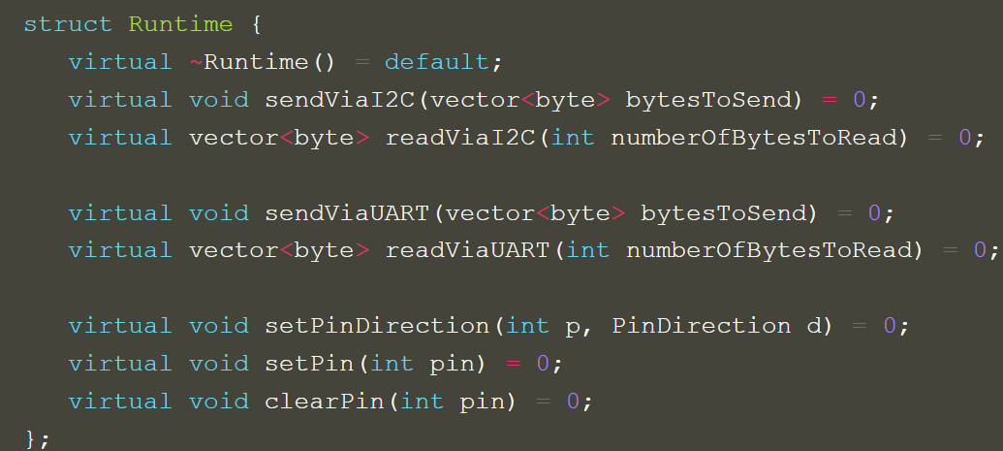
Interface Segregation Principle
“No client should be forced to depend on methods it does not use”
The interface class should have less pure virtual functions or interfaces
If we put lot of interfaces in single abstract class, then clients whoever derive it must implement all of its interfaces even though may not be used
This class violates the principle of interface segregation principle because too many hardware interfaces are declared in single class – Every class which inherit this class must implement all of pure virtual functions

Slide 8
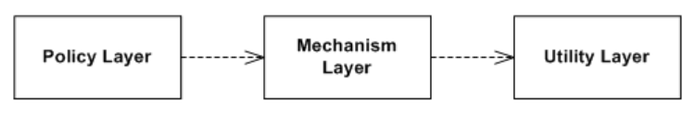
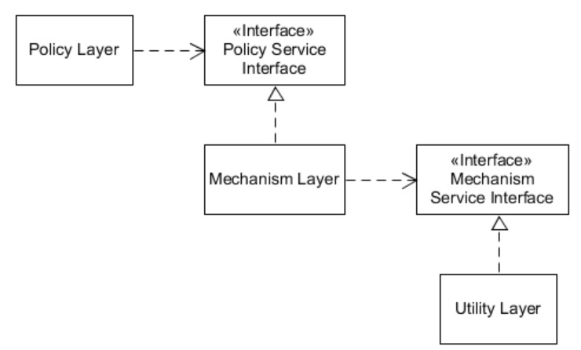
Dependency of Inversion principle
The Dependency Inversion Principle (DIP) suggest that the most flexible systems are those in which source code dependencies refer only to abstractions, not to concretions
High-level modules should not depend on low-level modules, Both should depend on abstractions
There are many ways you can implement DIP, as long as C++ concerns most people use static polymorphism
DIP is also known as Coding To Interface - Because first we will design abstraction and then implement lower layer
Hence all STL are designed with generic containers
The dependency of inversion principle is violated here because higher layer directly depend on low level module
The dependency of inversion principle is Followed here because higher layer doesn’t directly depend on low level module.. Rather abstraction layer is used (Interface)

Slide 9
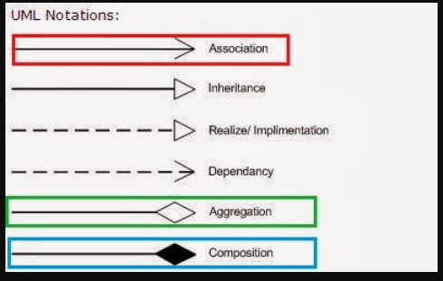
OOPS Principles
Association
Aggregation
Composition
Inheritance
Realization/Implementation
Dependency

Slide 10
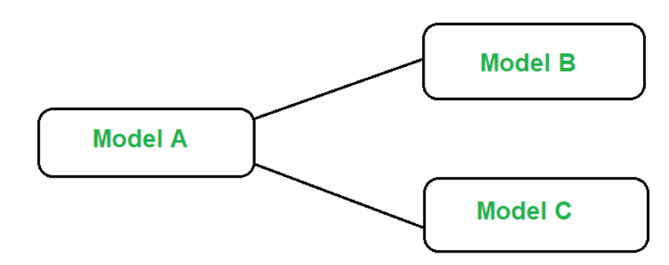
Association
It is generalized concept of relations – It can be both aggregation and composition
It represents a binary relationship between two objects that describes an activity
It is a relationship between objects. For example, A doctor can be associated with multiple patients
Association means that one object uses another object or a function/method in that other object
An association is a “using” relationship between two or more objects in which the objects have their own lifetime and there is no owner
Association is known as a HAS-A relationship
In UML an association relationship is represented by a single arrow.
An association relationship can be represented as one-to-one, one-to-many, or many-to-many (also known as cardinality)

Slide 11
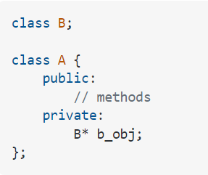
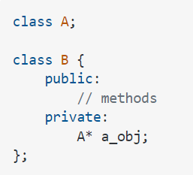
Association
The implementation of Association needs “pointer” or “reference” of class in another class
Implemented using “Forward Declaration” in c++

Slide 12
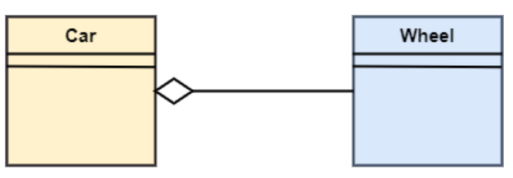
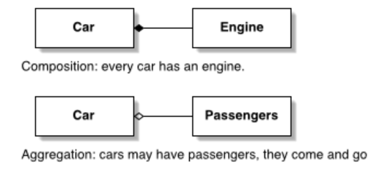
Aggregation
Aggregation is used to represent the 'HAS-A+’ relationship between two objects
It is form of association where no ownership exit between objects
The objects are independent each other
Life cycle of object doesn’t impact the life cycle of another object
Aggregation represents unidirectional relation between the objects of 2 classes. It is a one-direction relation.
source code example
A car cannot move without a wheel. But the wheel can be independently used with the bike, scooter, cycle, or any other vehicle. The wheel object can exist without the car object, which proves to be an aggregation relationship
https://github.com/shidlingayya/CPP-Examples/blob/0deb2880c73696a549ac0aca41c07135534d7a5f/Aggregation%20Example.cpp

Slide 13
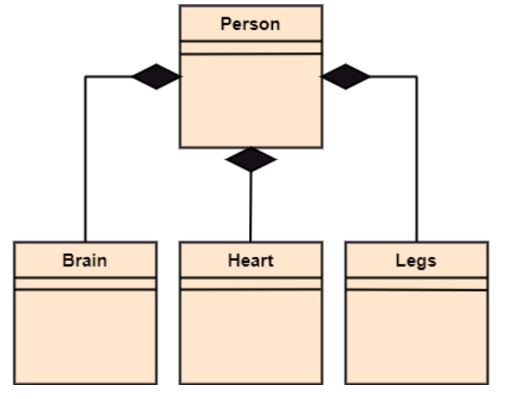
Composition
A class is written in such a way that the object of another existing class becomes a member of the new class
It is also known as containment, part-whole, or has-a relationship
The composition association relationship connects the Person class with Brain class, Heart class, and Legs class. If the person is destroyed, the brain, heart, and legs will also get discarded.

Slide 14
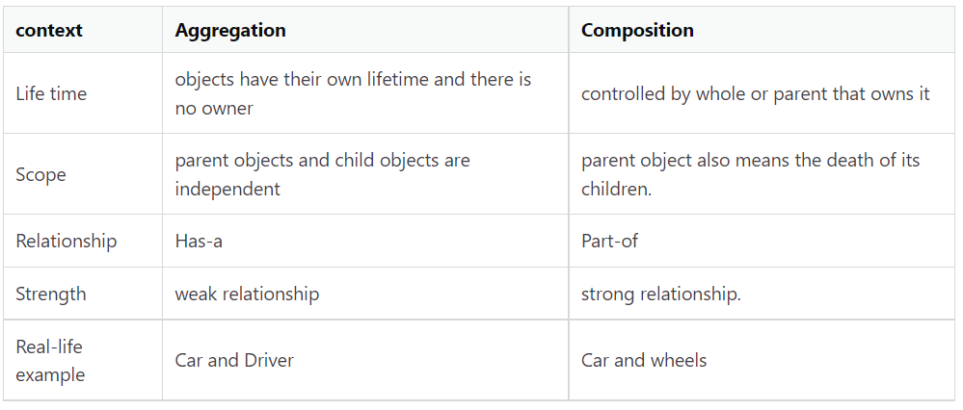
Composition V/S Aggregation

